Slide 1
UPPER SIXTH ARTS
GEOGRAPHY
Map Analysis 9
Urban Settlements on Maps
Notes:
Good morning, class, and welcome to our geography lesson. I am your geography teacher, Mr Kamdem. Today we are starting Map Analysis 9: Urban Settlements on Maps.

Slide 2
CLASS INFO
Class, Chapter and Duration
Class | Upper Sixth Arts
Chapter | Module 8: Understanding and carrying out statistical techniques, topographic map analysis, fieldwork and project based learning
Duration | 2 periods (2 × 50 minutes)
Notes:
This lesson is for Upper Sixth Arts. It belongs to Module 8: Understanding and carrying out statistical techniques, topographic map analysis, fieldwork and project based learning. We shall need 2 periods to cover it.

Slide 3
IDENTIFICATION
Lesson Identification
Topic | Topographic Map Analysis
Sub-topic | Settlement Analysis
Lesson | Map Analysis 9: Urban Settlements on Maps
Notions / Concepts | Urban morphology, CBD, functional zone, land-use segregation, street pattern.
Syllabus focus | Urban morphology (shape, size, layout); functional zones and land-use segregation.
Competence | Learners are able to describe urban morphology and functional zones from a map.
Notes:
Our topic is Topographic Map Analysis, and the sub-topic is Settlement Analysis. The key notions we shall use today are: urban morphology, CBD, functional zone, land-use segregation, street pattern. At the end, you should be able to do this: learners are able to describe urban morphology and functional zones from a map.

Slide 4

HOMEWORK CORRECTION
Correction of the Homework
Question (Map Analysis 8: Rural Settlements on Maps):
Calculate the NNI for the huts in one grid square of a map extract.
Notes:
Before we start the new lesson, let us correct the homework I gave you at the end of Map Analysis 8: Rural Settlements on Maps. The question was: Calculate the NNI for the huts in one grid square of a map extract. Take out your exercise books.

Slide 5
HOMEWORK CORRECTION
Correction: Possible Answer
Example: 10 huts, mean nearest distance 0.2 km, area 1 km². Rn = 2 × 0.2 × √(10 ÷ 1) = 0.4 × 3.16 = 1.26: a slightly random-to-dispersed pattern.
Notes:
Here is a good answer. Example: 10 huts, mean nearest distance 0.2 km, area 1 km². Rn = 2 × 0.2 × √(10 ÷ 1) = 0.4 × 3.16 = 1.26: a slightly random-to-dispersed pattern. Compare it with your own answer and correct your work in red.

Slide 6
LESSON PLAN
Lesson Plan
Correction of the homework
Objectives and recall
Real-life situation and action to take
Learning activities
Board summary
Evaluation, remediation and homework
Notes:
Here is the plan of our lesson today. First, we shall correct the homework. Then we shall look at the objectives and recall what you already know. After that, we shall study a situation from real life and the action to take, and do the learning activities. Finally, we shall copy the board summary, do the evaluation and the remediation, and I will give you the homework.

Slide 7
OBJECTIVES
Objectives
By the end of this lesson, you should be able to:
Describe the shape, size and layout of a town.
Identify functional zones.
Explain land-use segregation.
Notes:
By the end of this lesson, you should be able to do three things. Number 1: describe the shape, size and layout of a town. Number 2: identify functional zones. Number 3: explain land-use segregation.

Slide 8
PREVIOUS KNOWLEDGE
Previous Knowledge
Towns have a CBD, industrial and residential areas.
Towns grow along roads.
Notes:
Let us first remember what you already know. Towns have a CBD, industrial and residential areas. Towns grow along roads. Keep this in mind, because we shall build on it today.

Slide 9
REAL-LIFE SITUATION
Situation in Real Life
A town plan shows a dense grid of buildings in the centre, factories near the railway and river, spacious houses with gardens on one side and crowded houses on another.
Notes:
Listen carefully to this situation from real life. A town plan shows a dense grid of buildings in the centre, factories near the railway and river, spacious houses with gardens on one side and crowded houses on another. Think about it, because I am going to ask you some questions.

Slide 10
REAL-LIFE SITUATION
Situation: Question 1
What is the problem in the situation?
Notes:
Question 1: What is the problem in the situation? Think for a moment, then raise your hand to answer.

Slide 11
REAL-LIFE SITUATION
Answer
The class must identify and explain urban zones.
Notes:
Good. The class must identify and explain urban zones.

Slide 12
REAL-LIFE SITUATION
Situation: Question 2
What is the dense centre called?
Notes:
Question 2: What is the dense centre called? Think for a moment, then raise your hand to answer.

Slide 13
REAL-LIFE SITUATION
Answer
The Central Business District (CBD).
Notes:
Good. The Central Business District (CBD).

Slide 14
REAL-LIFE SITUATION
Situation: Question 3
Why are factories near the railway?
Notes:
Question 3: Why are factories near the railway? Think for a moment, then raise your hand to answer.

Slide 15
REAL-LIFE SITUATION
Possible Answer
For transport of goods.
Notes:
Good. For transport of goods.

Slide 16
ACTION TO TAKE
Action to Take
Read the structure of towns from maps and plan them better.
Notes:
From this situation, the action we are working towards in this lesson is the following: read the structure of towns from maps and plan them better.

Slide 17
JUSTIFICATION
Justification of the Lesson
This lesson helps us to read the structure of towns on maps.
Notes:
Why is this lesson important for you? This lesson helps us to read the structure of towns on maps.

Slide 18
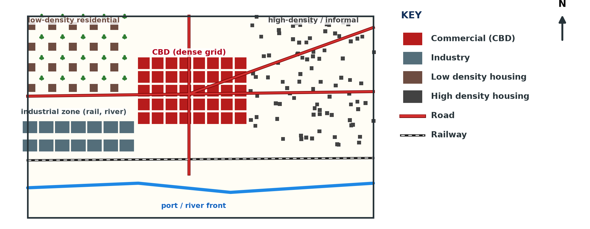
1. URBAN MORPHOLOGY
Activity 1
A town plan (invented).
Notes:
Activity 1. Look carefully at this diagram: a town plan (invented). Observe every detail before I ask the question.

Slide 19
1. URBAN MORPHOLOGY
Activity 1: Question
Describe the shape and street pattern of the town.
Notes:
Here is the question for Activity 1: Describe the shape and street pattern of the town. Take one minute to think and write your answer in your rough notebook.

Slide 20
1. URBAN MORPHOLOGY
Activity 1: Answer
It spreads along the river and roads; the centre has a grid pattern.
Notes:
Let us check the answer together. It spreads along the river and roads; the centre has a grid pattern.

Slide 21
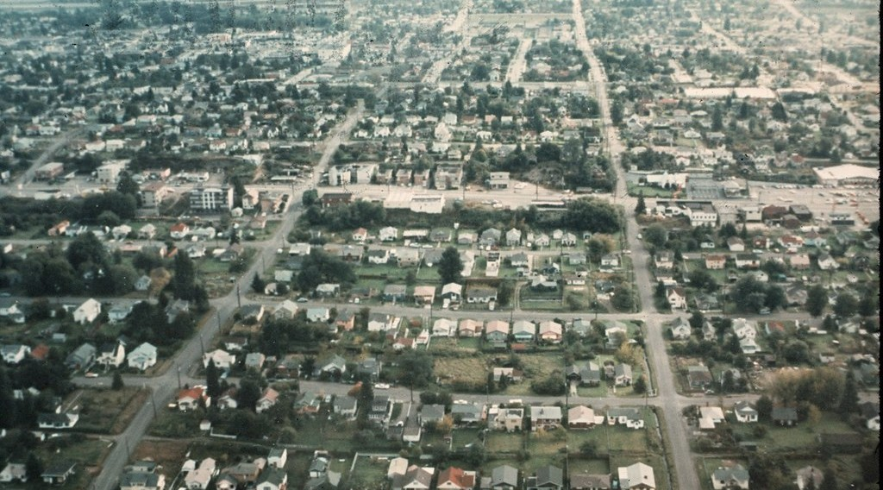
1. SHAPE AND SIZE
Activity 2
A town from the air.
Notes:
Activity 2. Look carefully at this picture: a town from the air. Observe every detail before I ask the question.

Slide 22
1. SHAPE AND SIZE
Activity 2: Question
How can you measure the size of a town on a map?
Notes:
Here is the question for Activity 2: How can you measure the size of a town on a map? Take one minute to think and write your answer in your rough notebook.

Slide 23
1. SHAPE AND SIZE
Activity 2: Answer
Count grid squares covered by built-up area and use the scale.
Notes:
Let us check the answer together. Count grid squares covered by built-up area and use the scale.

Slide 24
2. FUNCTIONAL ZONES
Activity 3
Functional zones.
Notes:
Activity 3. Look carefully at this diagram: functional zones. Observe every detail before I ask the question.

Slide 25
2. FUNCTIONAL ZONES
Activity 3: Question
Name four functional zones on the plan.
Notes:
Here is the question for Activity 3: Name four functional zones on the plan. Take one minute to think and write your answer in your rough notebook.

Slide 26
2. FUNCTIONAL ZONES
Activity 3: Answer
CBD, industrial zone, low-density and high-density residential zones.
Notes:
Let us check the answer together. CBD, industrial zone, low-density and high-density residential zones.

Slide 27
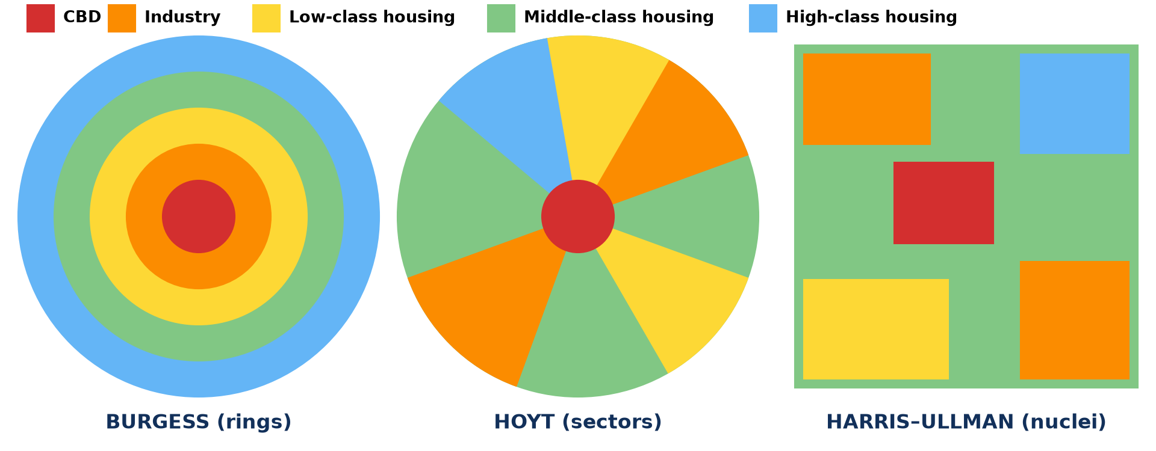
3. LAND-USE SEGREGATION
Activity 4
Models of city structure.
Notes:
Activity 4. Look carefully at this diagram: models of city structure. Observe every detail before I ask the question.

Slide 28
3. LAND-USE SEGREGATION
Activity 4: Question
Why are rich and poor residential areas separated?
Notes:
Here is the question for Activity 4: Why are rich and poor residential areas separated? Take one minute to think and write your answer in your rough notebook.

Slide 29
3. LAND-USE SEGREGATION
Activity 4: Answer
Land prices, income and planning separate them.
Notes:
Let us check the answer together. Land prices, income and planning separate them.

Slide 30

3. EXPLANATION
Activity 5
Douala.
Notes:
Activity 5. Look carefully at this picture: douala. Observe every detail before I ask the question.

Slide 31
3. EXPLANATION
Activity 5: Question
Why is the CBD in the centre?
Notes:
Here is the question for Activity 5: Why is the CBD in the centre? Take one minute to think and write your answer in your rough notebook.

Slide 32
3. EXPLANATION
Activity 5: Answer
It is the most accessible point, where roads meet.
Notes:
Let us check the answer together. It is the most accessible point, where roads meet.

Slide 33
BOARD SUMMARY
Board Summary
Topic: Topographic Map Analysis
Sub-topic: Settlement Analysis
Map Analysis 9: Urban Settlements on Maps
Notes:
Now we are going to copy the board summary. Write the title and the headings neatly in your notebooks. I will give you enough time for each slide, so do not rush.

Slide 34
BOARD SUMMARY
1. Urban Morphology
The morphology of a town is described as follows:
Shape: A town may be compact, linear along routes or star-shaped along several roads. Relief and rivers often limit its shape.
Notes:
Let us copy Urban Morphology. The morphology of a town is described as follows. On this slide we have Shape. Write each point on a new line, with the key term first, and explain it in your own words when we revise. When you finish, we go to the next slide.

Slide 35
BOARD SUMMARY
1. Urban Morphology (continued)
Size: Size is measured by counting grid squares covered by built-up area and using the scale. It shows the importance of the town.
Notes:
We continue with Urban Morphology. On this slide we have Size. Write each point on a new line, with the key term first, and explain it in your own words when we revise. When you finish, we go to the next slide.

Slide 36
BOARD SUMMARY
1. Urban Morphology (continued)
Layout: The street pattern may be a grid in planned areas or irregular in old and unplanned areas. Main roads meet in the centre.
Notes:
We continue with Urban Morphology. On this slide we have Layout. Write each point on a new line, with the key term first, and explain it in your own words when we revise.

Slide 37
BOARD SUMMARY
1. Urban Morphology
Illustration: a town plan (invented)
Notes:
Now draw this illustration in your notebook: a town plan (invented). Give it a title and label it clearly.

Slide 38
BOARD SUMMARY
2. Functional Zones
A town has the following functional zones:
CBD: The central business district has shops, banks and offices at the most accessible point. It has the highest land values.
Notes:
Let us copy Functional Zones. A town has the following functional zones. On this slide we have CBD. Write each point on a new line, with the key term first, and explain it in your own words when we revise. When you finish, we go to the next slide.

Slide 39
BOARD SUMMARY
2. Functional Zones (continued)
Industrial zone: Factories are located near railways, rivers or main roads, often at the edge of town. They need space and transport.
Residential zones: Low-density zones have large plots for rich people, while high-density zones are crowded. Planned estates and slums may both be found.
Notes:
We continue with Functional Zones. On this slide we have Industrial zone and Residential zones. Write each point on a new line, with the key term first, and explain it in your own words when we revise.

Slide 40
BOARD SUMMARY
3. Land-use Segregation
Land uses in towns are separated for the following reasons:
Economic reasons: Land prices and incomes separate rich and poor residential areas. Shops locate where many people pass.
Notes:
Let us copy Land-use Segregation. Land uses in towns are separated for the following reasons. On this slide we have Economic reasons. Write each point on a new line, with the key term first, and explain it in your own words when we revise. When you finish, we go to the next slide.

Slide 41
BOARD SUMMARY
3. Land-use Segregation (continued)
Planning and models: Planning laws separate industry from housing. Burgess, Hoyt and Harris–Ullman models describe these zones.
Notes:
We continue with Land-use Segregation. On this slide we have Planning and models. Write each point on a new line, with the key term first, and explain it in your own words when we revise.

Slide 42
BOARD SUMMARY
3. Land-use Segregation
Illustration: models of city structure
Notes:
Now draw this illustration in your notebook: models of city structure. Give it a title and label it clearly.

Slide 43
FORMATIVE EVALUATION
Evaluation 1
Name three functional zones and give map evidence for one.
Notes:
Now let us check what you have understood. Question 1: Name three functional zones and give map evidence for one. Answer in your exercise book.

Slide 44
FORMATIVE EVALUATION
Expected Answer
CBD, industrial, residential; industry: factories near the railway.
Notes:
The expected answer is: cBD, industrial, residential; industry: factories near the railway. If you got it right, well done.

Slide 45
FORMATIVE EVALUATION
Evaluation 2
Give two causes of land-use segregation.
Notes:
Now let us check what you have understood. Question 2: Give two causes of land-use segregation. Answer in your exercise book.

Slide 46
FORMATIVE EVALUATION
Expected Answer
Land prices and planning.
Notes:
The expected answer is: land prices and planning. If you got it right, well done.

Slide 47
REMEDIATION
Remediation
Fill in the blanks:
The shape and layout of a town is urban ______.
The commercial centre is the ______.
Industry is near ______ and rivers.
Notes:
For those who need more practice, fill in the blanks in your exercise book. The answers are: number 1, morphology; number 2, CBD; number 3, railways.

Slide 48
HOMEWORK
Homework
Draw a sketch map of the functional zones of your town.
Notes:
For your homework: Draw a sketch map of the functional zones of your town. We shall correct it at the beginning of our next lesson.

Slide 49
NEXT LESSON
Next Lesson
Our next lesson will be on:
Quantitative Techniques 1: Analysis of Cartographic Tools
Notes:
Our next lesson will be on Quantitative Techniques 1: Analysis of Cartographic Tools. Thank you for your attention, and see you next time.

Slide 50
BILINGUAL GAME
Bilingual Game (Jeu Bilingue)
English | Français
Town plan | Le plan de ville
Street | La rue
Zone | La zone
Housing | L'habitat
Industrial zone | La zone industrielle
Segregation | La ségrégation
Notes:
Let us play the bilingual game. I say a word in English, and you give me the French word. Then we do the reverse.

Slide 51
LOGBOOK
Official Logbook (1/2)
Module / Topic | Topographic Map Analysis
Lesson Title | Map Analysis 9: Urban Settlements on Maps
Expected Learning Outcomes | Describe the shape, size and layout of a town. Identify functional zones. Explain land-use segregation.
Competence | Learners are able to describe urban morphology and functional zones from a map.
Notes:
I record this information in the official logbook of the class after the lesson.

Slide 52
LOGBOOK
Official Logbook (2/2)
Matter Taught | Urban Morphology; Functional Zones; Land-use Segregation.
Evaluation | Formative evaluation and remediation exercise.
Homework | Draw a sketch map of the functional zones of your town.
Enrolment / Present / Absent | ____ / ____ / ____
Achievement | To be completed after the lesson.
Notes:
I complete the second page of the logbook: the matter taught, the evaluation, the homework and the attendance.

Slide 53
TEACHER'S NOTE
Teacher's Note
Timing: Homework correction, plan, objectives 8 min | Recall, situation, action 10 min | 5 activities 30 min | Board summary (copying) 30 min | Evaluation, remediation 10 min | Homework, next lesson 5 min | Logbook 7 min
Without the projector (Activity 1): describe the plan.
Without the projector (Activity 2): measure a town.
Without the projector (Activity 3): sketch the zones.
Without the projector (Activity 4): discuss your town.
Without the projector (Activity 5): explain the CBD.
Notes:
This slide is for me, the teacher: it gives the timing of the lesson and what to do if the projector is not available.

Slide 54
REFERENCES
References
National Geography Syllabus, MINESEC/IGE/IP-SS, 2019 — Module 8 (Practical Geography).
Photo, Activity 2: “Aerial of Greenwood, 1969” by Seattle Municipal Archives, CC BY 2.0, via Flickr (https://www.flickr.com/photos/24256351@N04/10161924795)
Photo, Activity 5: “Douala” by christing-O-, CC BY 2.0, via Flickr (https://www.flickr.com/photos/76187282@N00/7227535754)
Diagrams and animations: drawn for this lesson (Geography Department).
Notes:
These are the references and picture credits used to prepare this lesson.

